Slide 1
UNIT 2
PROBLEM DECOMPOSITION AND PLANNING

Slide 2
Departmental Vision –
Empowering the students to be professionally competent & socially responsible for techno-economic development of society.
Departmental Mission –
To provide quality education enabling students for higher studies, research and entrepreneurship.
b) To inculcate professionalism and ethical values through day to day practices.

Slide 3
Course Outcomes:
CO1 : Able to identify and apply the concept of AI and various search strategies in various AI applications.
CO2 : Able to apply Artificial Intelligence techniques for problem solving.
CO3: Able to design a knowledge based system.
CO4 : Able to apply the methods to new NLP problems and to solve the problems outside NLP.
CO5 : Able to understand and design robot system control.
CO6 : To understand and analyze various types of robots in practice.

Slide 4
Rule-based Expert Systems
Also known as production systems or expert systems.
Rules are the popular paradigm for representing knowledge.
Rules are expressed as a set of if-then statements (called IF-THEN rules or production rules)
A rule based expert system is one whose knowledge base contains the domain knowledge coded in the form of rules.

Slide 5
A rule based system uses rules as the knowledge representation.
Instead of representing knowledge in a declarative, static way rule-based system represent knowledge in terms of a set of rules that tells what to do or what to conclude in different situations.
A rule-based system can be simply created by using a set of assertions and a set of rules that specify how to act on the assertion set.

Slide 6
A rule-based system consists of a set of IF-THEN rules, a set of facts and some interpreter controlling the application of the rules, given the facts.
IF P THEN Q which is also equivalent to: P⇒Q.
The idea of an expert system is to use the knowledge from an expert system and to encode it into a set of rules.

Slide 7
Components of Expert Systems
An expert system is typically composed of at least three primary components. These are the inference engine, the knowledge base, and the User interface.
Knowledge Base - The knowledge base is a collection of rules or other information structures derived from the human expert. Rules are typically structured as If/Then statements of the form:
IF <antecedent> THEN <consequent>
Agenda - When rules are satisfied by the program, they are added to a queue called the agenda. The agenda is an unordered list of all the rules whose antecedents/conditions are currently satisfied.
2. Inference Engine - It is the main processing element of the expert system. The inference engine chooses rules from the agenda to fire. If there are no rules on the agenda, the inference engine must obtain information from the user in order to add more rules to the agenda.

Slide 8
3. User Interface
A user interface is the method by which the expert system interacts with a user.
4. Working Memory
Working memory contains the data that is received from the user during the expert system session.
Values in working memory are used to evaluate antecedents in the knowledge base.
Consequences from rules in the knowledge base may create new values in working memory, update old values, or remove existing values.

Slide 9
Knowledge Base
Facts can be seen as a collection of data and conditions.
Data associates the value of characteristics with a thing and conditions perform tests of the values of characteristics to determine if something is of interest.
For instance, if we have the fact: temperature < 0
then temperature is the data and the condition is < 0

Slide 10
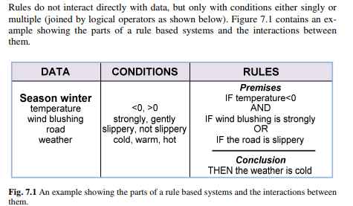

Slide 11
Forward and Backward Reasoning
Knowledge base architecture consists of set of rules, set of facts and inference engine.
Given a set of rules, there are new ways to generate new knowledge:
Forward Chaining -
Also called as data driven. It start with facts, and sees what rules apply.
2. Backward Chaining – Goal Driven
It start with goal state.

Slide 12
Forward Chaining/Reasoning/ Data Driven Rule-based Expert Systems
The process starts with start states i.e with given facts.
At each iteration, the next level is generated with selection of rule, whose left side matches with the root.
The process is from left to right evaluation of a rule.
The process is continued till goal is achieved.

Slide 13
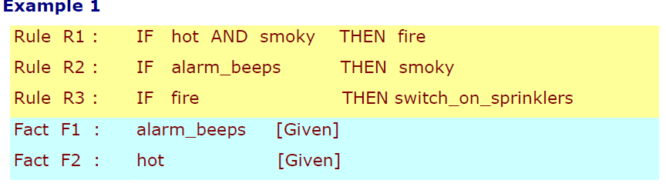
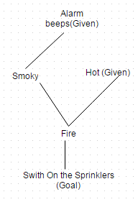
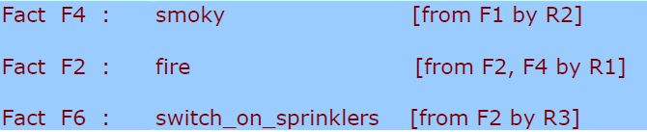
Goal is : Should sprinklers be switched on?
Solution

Slide 14
Backward Reasoning/ Goal-driven Rule-based Expert Systems
Reverse of forward Reasoning.
The rules start with the goal .
The rules whose right side matches with the root are considered.
The process of selection is from right to left.
Once a rule is applied, its left side is then looked upon searched in the right side again. This is continued till the initial state is reached.

Slide 15
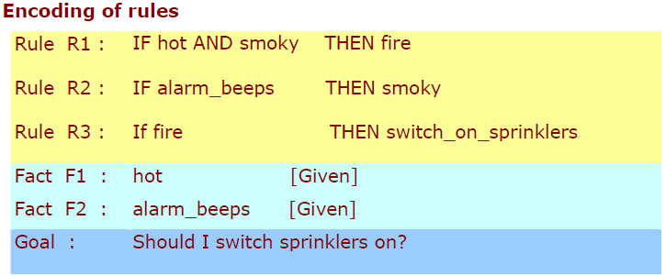
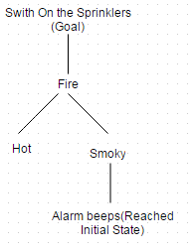
Backward Reasoning/ Chaining

Slide 16
Planning

Slide 17

Introduction
Some real life example
When planning is requires?
How planning helps in achieving goal?

Slide 18
Planning
Planning is the process of deciding sequence of actions that will lead to achieve goal.
Lots of constraints may exist during planning. Still the goal has to be achieved.
Planning involves the steps to be taken to reach the goal optimally.
Thus, we can say that it determines how and when to do the necessary steps given the set of goals.

Slide 19
Role of Planning in AI
Intelligent systems needs to be aware of what is to be done and how it can be done.
Planning allows to explore(to find out) different possibilities that exist in order to solve a problem.
It makes the intelligent system more flexible and increases their decision making capabilities.
In order to plan, problem needs to be well understood.
Planning needs proper representation of what has to be achieved.
Planning involves reasoning.

Slide 20

Planning Problem
Planning problem is defined with
1) Domain model consists of:-
Objects
Actions
Operators – They describe action.
State Constraints.
2) Initial State – State where action is yet to take place.
3) Final/ Goal State – State which plan is intended to achieve
Planning problem is actually question that how to go to next state from current state

Slide 21
Components Of Planning System
The components of planning system are:
1.Selection of best rule/action by use of heuristic.
2. Taking the action and applying the rule.
3. Understanding and recognizing when the goal is reached or the solution is found.
4. Understanding and recognizing the dead ends.
5. Understanding and recognizing partial solution that is correct and making efforts to make it entirely accurate.

Slide 22

Representation Of Planning
In order to plan, one should represent the problem properly.
Representation of the planning problem
involves mapping of states, actions and goals.
The language used for representation
must be concrete, understandable and
expressive.
There are different representation like propositional, first order, state variable.

Slide 23
1) Sate Representation
State is represented as conjunction of positive literals, using first order logic.
Literals in FOL should be ground terms
( i.e without any function).
Any condition about the world that are not mentioned are assumed to be false. (i.e Close world assumption).
For eg:- At(Ram, Lanka) – Correct.
At(Son-of(Dashrath), Ayodhya) – Incorrect.
Since the function(son_of is not allowed.)

Slide 24
2) Representing Goals
It is partially specified test.
It is represented as conjunction of positive ground literals.
A state or proposition is said to be achieved or satisfied if-
It consists of all the objects required for goal or may be some other too.
For eg:- If the goal is kind ^ hardworking and the state has kind^ hardworking ^ pretty. So it fulfils/ satisfy the goal.

Slide 25
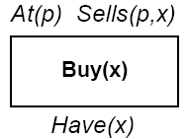
3) Representing Actions
When we decide to something, we are aware of the states we are in and what are the possible effects after taking the action.
So an action is represented using 2 components:-
Preconditions- That should hold before the action can be executed.
Effects/ Post conditions – They are the output that will come after executing an action.
Example
Action: Buy(x)
Precondition: At(p), Sells(p, x)
Effect: Have(x)

Slide 26



Planning agent
A planning agent is one that makes use of knowledge and problem solving to get the goal.
Steps:
Defining the goal
Planning
Taking action

Slide 27
Planning Languages
Standard Research Institute Problem Solver (STRIPS)
Action Description Language (ADL)
Planning Domain Description Language (PDDL)

Slide 28
Stanford Research Institute Problem Solver (STRIPS)
STanford Research Institute Problem Solver was developed in 1970’s at Stanford for first intelligent robot.
It makes use of first order predicates.
It allows function free literals.
Only positive literals in states: Poor ∧ Unknown
Closed world assumption: Unmentioned literals are false
Goals are conjunctions: Rich ∧ Famous
Effects are conjunction.
No support for equality
No support for different data types

Slide 29
STRIPS
Eg:- Consider car driving case
Action - (drive(c, from, to))
Pre condition : at(c, from) ^ car(c)
Post condition :Add list - at(c, to)
: Delete list - ~ at(c, from)
Add list – List of things that becomes TRUE after performing the action.
Delete List - List of things that becomes FALSE after performing the action.

Slide 30


Standard Research Institute Problem Solver (STRIPS)
Developed in 1970 at Standfort for first intelligent robot.
Uses FOL
Example: agent with environment having a cup of tea, guest and two rooms.
Goal: robot should get the tea and give it to guest .
Room 1
Room 2

Slide 31
State Representation:
In(agent,room1) ^ in(tea, room2) ^in(guest,room2)
In(agent,room1) ^ in(tea, room1) ^in(guest,room1)
In(agent,room2) ^ in(tea, room1) ^in(guest,room1) and so on…
Action Representation
Action have name , pre and post condition
Action 1: MOVE-TO-ROOM2
Pre-condition: in(agent, room1)
Post-condition: add-list (agent, room2)
delete-list: (agent, room1)
Language is restricted.
It assumes propositions in limited numbers.

Slide 32
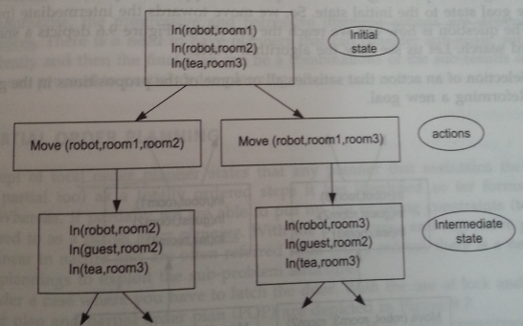
Example
Consider a robot is in Room 1 and guest and tea are in room 2 and 3. So progressing planning for it will be:-

Slide 33
STRIPS
Advantage:-
Easy to understand.
Use of propositional logic makes implementation and building of Knowledge base easy. Hence inference and reasoning becomes simple.
Disadvantages:-
The language is restricted.
Cannot handle large number of propositions.

Slide 34
Action Description Language (ADL)
Properties
It allow negative literals
Make use of quantifiers
Conditional post-conditional are allowed
Variable with different types at the same time are allowed and also equality

Slide 35
Planning Domain Description Language (PDDL)
Superset of STRIPS and ADL
Features
Object can have type specification
It can have negative pre-condition
The add and delete lists can be conditional
In some cases, it also allow numeric values
Domain file:
(define (domain<domain_name>)
<PDDL code for predicates>
<PDDL code for actions>
Problem file:
(define (problem<problem_name>)
(:domain<doman_name>)
<PDDL code for objects>
<PDDL code for initial states>
<PDDL code for goal specification>

Slide 36
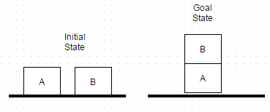
Block Word Problem
Planning = generating a sequence of actions to achieve the goal from the start

Slide 37
Predicates used here are:
On(A, table) : Block A is on table.
On(B, table) : Block B is on table.
On(B,A) : Block B is on block A.
Clear(A) : Block A has nothing on it.
Clear(B) : Block B has nothing on it.
Holding (B): Robot’s hand is holding block B
Empty Hand : Robot’s hand is not holding anything

Slide 38
State Representation can be as follows:
On(A, table)^ On(B, table)^ Clear(A)^ Clear(B) ^ Empty Hand (Initial State)
On(A, table)^ Holding(B) ^ Clear(A)
On(A, table)^ On(B, A)^ Clear(B)^Empty Hand (Final State)

Slide 39
Actions that take place are given below –
Unstack(B,A) : to lift/pop block B from A.
Stack(B,A) :to push/add block B on A.
Lift B: lift block B from table.
Place B: To put block B on table

Slide 40
The Blocks World
Conditions and results:
ON(A, B)
ONTABLE(A)
CLEAR(A)
HOLDING(A)
ARMEMPTY

Slide 41
The Blocks World
Specification of actions:
PRECONDITION: list of predicates that must be true for an operator to be applied.
ADD: list of new predicates that an operator causes to become true.
DELETE: list of old predicates that an operator causes to become false.
Predicates not in ADD nor DELETE are unaffacted.

Slide 42
The Blocks World
Specification of actions:
STACK(x, y):
P: CLEAR(y) ∧ HOLDING(x)
D: CLEAR(y) ∧ HOLDING(x)
A: ARMEMPTY ∧ ON(x, y)
UNSTACK(x, y):
P: ON(x, y) ∧ CLEAR(x) ∧ ARMEMPTY
D: ON(x, y) ∧ ARMEMPTY
A: HOLDING(x) ∧ CLEAR(y)

Slide 43
The Blocks World
Specification of actions:
PICKUP(x):
P: CLEAR(x) ∧ ONTABLE(x) ∧ ARMEMPTY
D: ONTABLE(x) ∧ ARMEMPTY
A: HOLDING(x)
PUTDOWN(x):
P: HOLDING(x)
D: HOLDING(x)
A: ONTABLE(x) ∧ ARMEMPTY

Slide 44
The Blocks World
B
C
B
A
C
D
A
D
start:
ON(B, A) ∧
ONTABLE(A) ∧
ONTABLE(C) ∧
ONTABLE(D) ∧
ARMEMPTY
goal:
ON(C, A) ∧
ON(B, D) ∧
ONTABLE(A) ∧
ONTABLE(D) ∧

Slide 45
Approaches to perform Planning
There are two approaches to planning:
State Space Planning-
Also called as planning as a state space search.
It works on state and operators.
Search takes place in both direction.
2. Plan Space Planning –
Search is carried out through space of plans.
We begin with some plan that may be incorrect or incomplete.
Ordering of actions is done to get correct plan.
Steps may be added or deleted.

Slide 46
State Space Search Planning
Forward state space search/Progression Planning.
Planning can be from initial sate to goal state.
2. Backward state space search/Regression Planning.
Planning starts from goal state to initial state.

Slide 47
Forward state space search Planning
This planning starts with initial state and proceeds with search.
The problem is given as:-
Start Sate
Goal Check
Actions
Step Cost – Cost associated with every action.

Slide 48
Example
Consider a robot is in Room 1 and guest and tea are in room 2 and 3. So progressing planning for it will be:-

Slide 49
Forward state space search Planning
Advantages:-
Complete
Disadvantages:-
If number of propositions increases it can’t be handled properly.
Possibility of getting irrelevant actions not leading to goal state.

Slide 50
Backward state space search Planning
To plan search is started from goal sate to initial sate.
The main advantage of backward search is that relevant actions are considered.

Slide 51
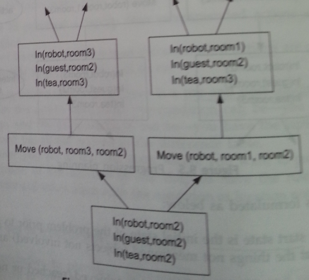
Backward state space search Planning
Goal State is – Robot, guest and tea are in room 2

Slide 52
Goal Stack Planning
Stack
Database
Goals
Operators to
satisfy
the Goals
Current situation
Specification of
Operators/Actions
+

Slide 53
Goal Stack Planning
Push the original goal to the stack. Repeat until the
stack is empty:
If stack top is a compound goal, push its unsatisfied subgoals to the stack.
If stack top is a single unsatisfied goal, replace it by an operator that makes it satisfied and push the operator’s precondition to the stack.
If stack top is an operator, pop it from the stack, execute it and change the database by the operation’s affects.
If stack top is a satisfied goal, pop it from the stack.

Slide 54
Goal Stack Planning
B
C
B
A
C
D
A
D
start:
ON(B, A) ∧
ONTABLE(A) ∧
ONTABLE(C) ∧
ONTABLE(D) ∧
ARMEMPTY
goal:
ON(C, A) ∧
ON(B, D) ∧
ONTABLE(A) ∧
ONTABLE(D) ∧

Slide 55
Goal Stack Planning
Stack
Database
ON(C, A)
ON(B, D)
ON(C, A) ∧ ON(B, D) ∧ OTAD
ON(B, A)
OTACD
ARMEMPTY
CLEAR(A)
HOLDING(C)
CLEAR(A) ∧ HOLDING(C)
STACK(C, A)
ON(B, D) ∧
ON(C, A) ∧ ON(B, D) ∧ OTAD
ON(B, A)
OTACD
ARMEMPTY

Slide 56
Goal Stack Planning
Plan
1. UNSTACK(B, A)
2. STACK(B, D)
3. PICKUP(C)
4. STACK(C, A)

Slide 57
Goal Stack Planning
A
C
B
A
B
C
start:
ON(C, A) ∧
ONTABLE(A) ∧
ONTABLE(B) ∧
ARMEMPTY
goal:
ON(A, B) ∧
ON(B, C)
Sussman Anomaly (1975)

Slide 58
Goal Stack Planning
Plan
1. UNSTACK(C, A)
2. PUTDOWN(C)
3. PICKUP(A)
4. STACK(A, B)
5. UNSTACK(A, B)
6. PUTDOWN(A)
7. PICKUP(B)
8. STACK(B, C)
9. PICKUP(A)
10. STACK(A, B)

Slide 59
Goal Stack Planning
Plan
1. UNSTACK(C, A)
2. PUTDOWN(C)
3. PICKUP(A)
4. STACK(A, B)
5. UNSTACK(A, B)
6. PUTDOWN(A)
7. PICKUP(B)
8. STACK(B, C)
9. PICKUP(A)
10. STACK(A, B)

Slide 60
Plan Space Planning
State-space search
Yields totally ordered plans (linear plans)
POP
Partial Ordering Planning is the planning as plan space search.
Works on sub problems independently, then combines sub plans.
Least Common Strategy - Decision or choices are not made unless required.
Advantage : - It avoids rework to be done.

Slide 61
Partial Order Planning (POP)
Totally ordered planning:
Maintain solution
Ordered steps
Also known as linear planner
Progression and regression planning(forward and backward state space search)
Least commitment strategy:
Where decisions or choices are delayed
‘do not make decision unless required’
Avoid rework
Example: submission of assignments
Allow to make choices relevant to current solvable part of problems

Slide 62
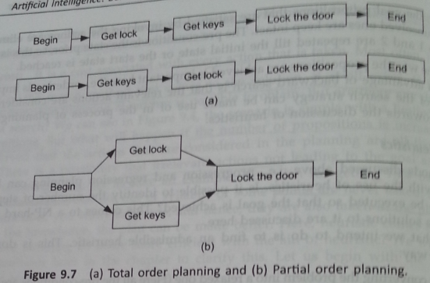
Example

Slide 63
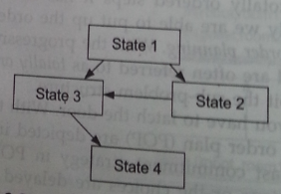
POP Representation
POP is represented in form of graphs.
Temporal Constraints –
State1 should occur before State2
Representation: State1< State2

Slide 64
Components of a Plan
A set of actions
A set of ordering constraints
A p B reads “A before B”
Cycles A p B and B p A should not exist.
A set of causal links (protection intervals) between actions
A B reads “A achieves p for B”.
4. A set of open preconditions.
If precondition is not achieved by action in the plan.
p

Slide 65
POP algorithm
Begin with initial plan.
It consists of start and finish steps.
2. Repeat the steps till the solution plan is achieved:
Add an pre- condition if it exists.
Resolve the threats by applying promotion and demotion.

Slide 66
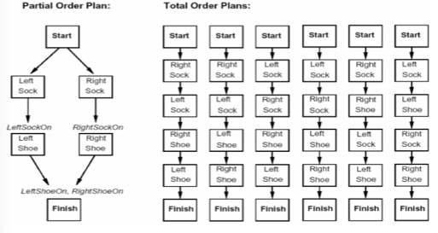
Partial Order Planning (POP) Representation
Represented in form of graph

Slide 67
Partial Order Planning(POP)
State-space search
Yields totally ordered plans (linear plans)
POP
POP is the planning as plan space search.
Works on sub problems independently, then combines sub plans.
Least Common Strategy - Decision or choices are not made unless required.
Advantage : - It avoids rework to be done.

Slide 68
Example

Slide 69
POP Representation
POP is represented in form of graphs.
Temporal Constraints –
State1 should occur before State2
Representation: State1< State2

Slide 70
Components of a Plan
A set of actions
A set of ordering constraints
A p B reads “A before B”
Cycles A p B and B p A should not exist.
A set of causal links (protection intervals) between actions
A B reads “A achieves p for B”.
p

Slide 71
POP algorithm
Begin with initial plan.
It consists of start and finish steps.
2. Repeat the steps till the solution plan is achieved:
Add an pre- condition if it exists.
Resolve the threats by applying promotion and demotion.

Slide 72
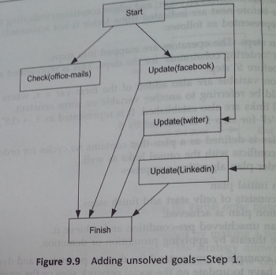
Example

Slide 73
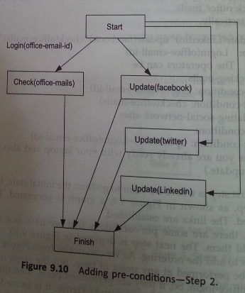
Step 2
Login into office email id is the precondition for checking office mails. So add this precondition.

Slide 74
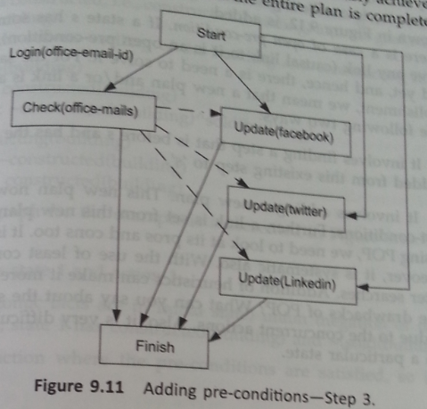
Step 3
Ordering constraints are added.

Slide 75
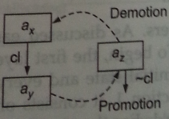
Threat - Clobbering
Consider ax and ay as action and e as effect.
ax ay
e
Eat an apple
Cut an apple
Buying an apple
Now consider if there is an action az that could have an effect ~e. Then it will create a threat.
This is resolved by-
Ordering az after ay ( Promotion)
Or ordering az before ax( Demotion)

Slide 76
Constraint Satisfaction Problems
Constraints are the natural medium for people to express problems in many fields.
Many real problems in AI can be modeled as Constraint Satisfaction Problems and are solved through search.
Examples Of Constraint:
The sum of three angles of a triangle is 180 degrees.
Constraint is a logical relation among variables.
Constraint Satisfaction is a process of finding a solution to a set of constraints.

Slide 77
Variety/ Types Of Constraints
Unary constraints involve a single variable.
e.g. South Africa ≠ green
Binary constraints involve pairs of variables.
e.g. South Africa ≠ Washington
Higher-order constraints involve 3 or more variables.
Professors A, B and C cannot be on a committee together
Can always be represented by multiple binary constraints
Preference (soft constraints)
e.g. red is better than green often can be represented by a cost for each variable assignment

Slide 78
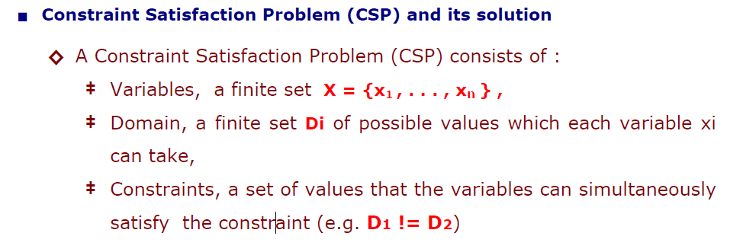
Constraint Satisfaction Problems
CSP in AI are:-
1. 8 queens problem- The constraint is no queen should threaten each other. A queen threatens other queen if present on same row, column, diagonal.
2. Map Coloring problem

Slide 79
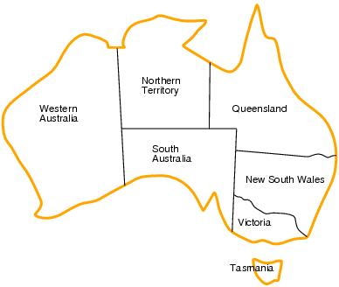
Map Coloring Problem
Given a map and number of colors, the problem is to assign colors to those area in map such that no adjacent nodes have same color.
Variables: WA, NT, Q, NSW, V, SA, T
Domains: D_{i}={red,green,blue}
Constraints: adjacent regions must have different colors.
E.g. WA ≠ NT

Slide 80
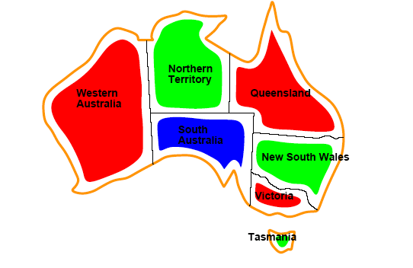
Solution

Slide 81
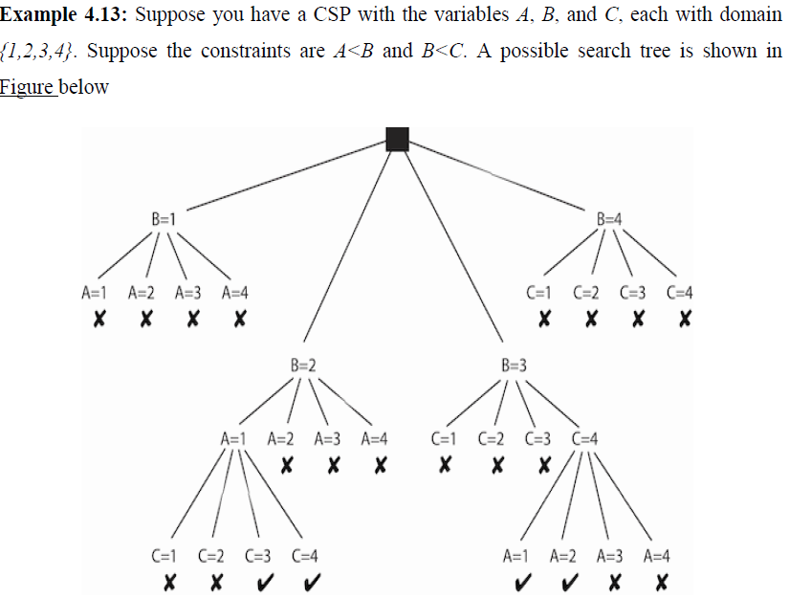
Example (2)

Slide 82
N-Queens
The N-Queens puzzle is a classic chess problem
Given a chessboard of size n by n, can you place n queens so that no two queens attack each other?
That is, can you place the queens with no two queens are on the same row, column, or diagonal?
The n-Queens puzzle has long been known to be simple to solve
You can solve the problem for all n except 2 and 3, and solutions for all other n can be described in a few lines.
This very simplicity has led to repeated controversy in Artificial Intelligence (AI).

Slide 83
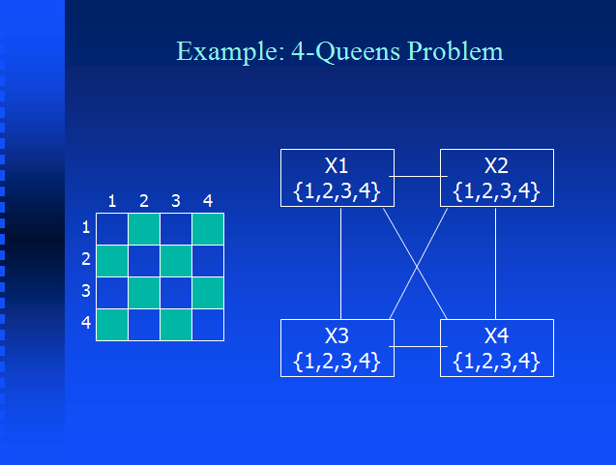

Slide 84
Constraint Propagation
A constraint is simply a logical relation among several unknowns (or variables), each taking a value in a given domain.
A constraint thus restricts the possible values that variables can take; it represents some partial information about the variables of interest.
For instance, “the circle is inside the square” relates two objects without precisely specifying their positions, i.e., their co-ordinates.
Now, one may move the square or the circle and he or she is still able to maintain the relation between these two objects.
Also, one may want to add another object, say triangle, and to introduce another constraint, say “square is to the left of the triangle”.
From the user (human) point of view, everything remains absolutely transparent.

Slide 85
Constraint Propagation-Properties
It may specify partial information, i.e., the constraint need not uniquely specify the values of its variables, (constraint X>2 does not specify the exact value of variable X, so X can be equal to
3, 4, 5 etc.)
Constraints are heterogeneous, i.e., they can specify the relation between variables with different domains (for example X = length(Y))
Constraints are non-directional, typically a constraint on (say) two variables X, Y can be used to infer a constraint on X given a constraint on Y and vice versa, (X=Y+2 can be used to compute the variable X using X:=Y+2 as well as the variable Y using Y:=X-2)
Constraints are declarative, i.e., they specify what relationship must hold without specifying a computational procedure to enforce that relationship,
Constraints are additive, i.e., the order of imposition of constraints does not matter, all that matters at the end is that the conjunction of constraints is in effect.
Constraints are rarely independent, typically constraints in the constraint store share variables.

Slide 86
Scene Labeling
IMAGE understanding is a task of primary importance for a wide range of practical applications.
One important step toward understanding an image is to perform a full-scene labeling, also known as a scene parsing
which consists of labeling every pixel in the image with the category of the object to which it belongs.

Slide 87
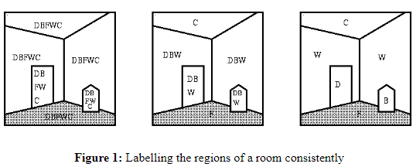
Scene Labeling - Example
Figure 1, below, illustrates schematically a room interior. The set of objects are denoted by regional boundaries and the set of possible labels is {Door(D), Wall(W), Ceiling(C), Floor(F), Bin(B) }.

Slide 88
Scene Labeling - Example
Unary Constraints
A Ceiling is the highest single region in the image
A Floor is chequered
Binary Constraints
A Wall is adjacent to a Floor and a Ceiling.
A Door is adjacent to a Floor and a Wall.
A Bin is adjacent to a Floor.
A Bin is smaller than a Door.
Initially we start with the complete set of possible labels for all the regions (2D), or surfaces (3D), in the image. Applying the unary constraints leads to a reduction in the number of possible labellings, but there is still ambiguity in at least 4 cases. These can be resolved by the binary constraints.

Slide 89
Assignment Questions
Explain Constraint Satisfaction Problem(CSP) by using example?
Explain CSP as a search Problem using example also show graph representation of a search problem?
Explain N-Queens Problem ?
What is Problem Decomposition explain Goal Trees with example?
Define Rule Based Systems with proper diagram?
What is Planning? Explain STRIPS with example
Explain Forward and Backward State Space Planning with example
Explain Goal Stack Planning with example

